Slide 1

The implications of picking A FSM over microstore
Electrical Engineering, EEMCS
Joost Buursink Fabian Widlund Emil Imhagen
Guus branderhorst
Stach Redeker Group 7

Slide 2
Our presentation is a little bit different

Slide 3
FSM? Microstore?
Let’s summarize quickly

Slide 4
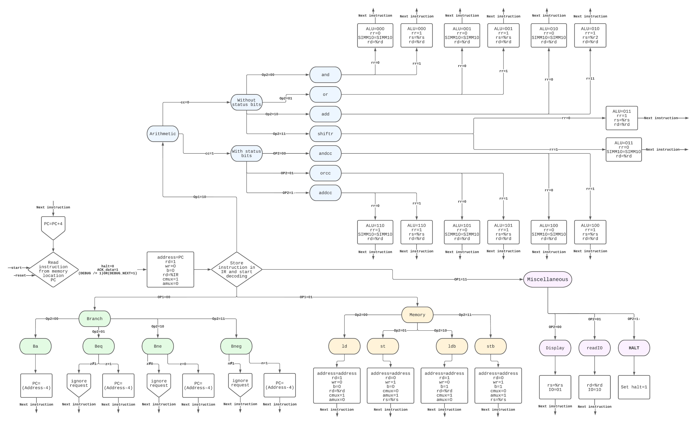
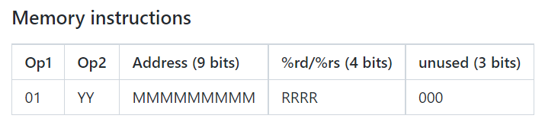
Finite state machine (fsm)

Slide 5
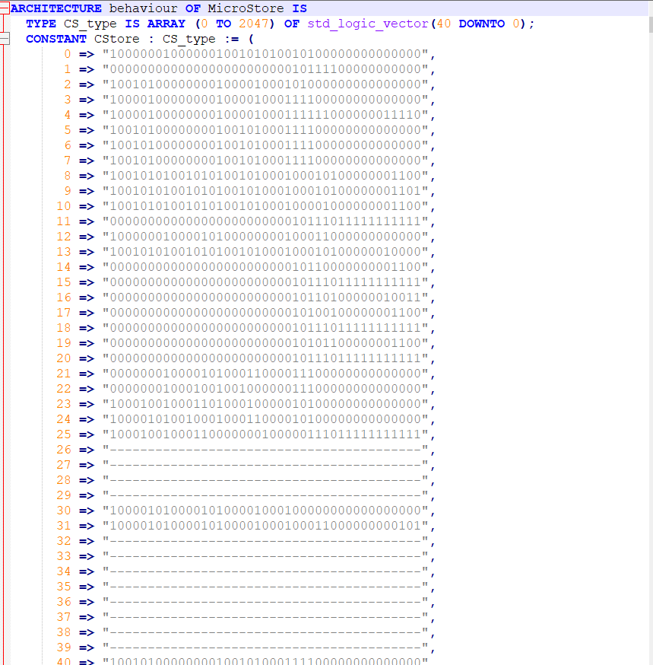
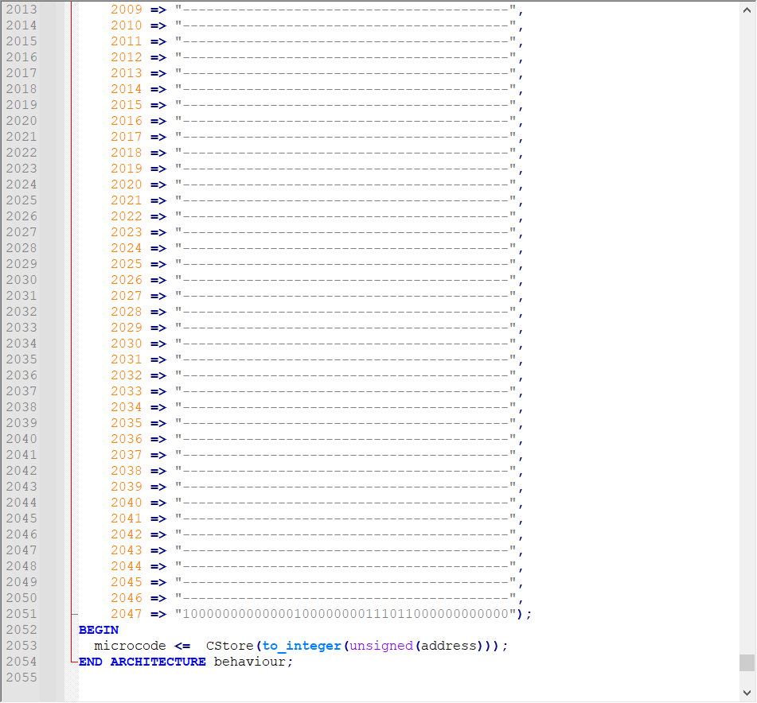

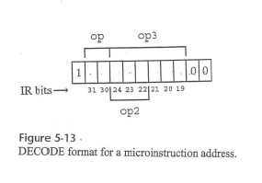
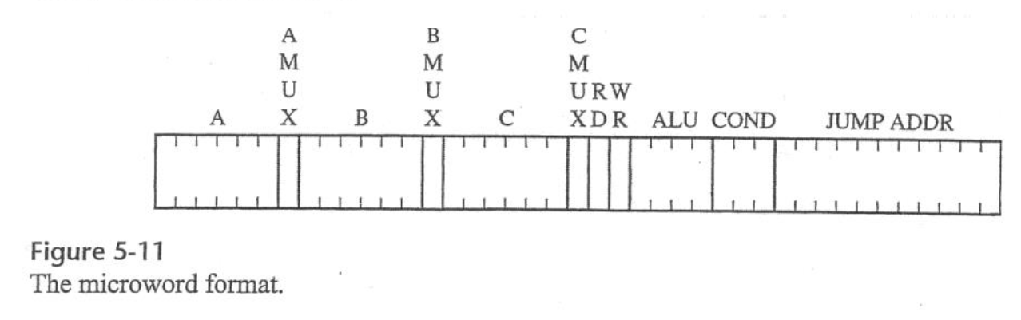
Microstore

Slide 6
Our hypothesis
FSM Microstore
Quite elegant for small instruction sets
Human readable
Can get quite large
Scales better for larger instruction sets
Not human readable
Requires a large LUT small instruction sets

Slide 7
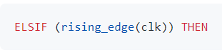
The implications of using a FSM

Slide 8
The implications of using a FSM

Slide 9
The implications of using a FSM

Slide 10
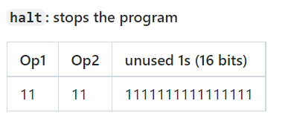
How do WE halt?

Slide 11
How do WE halt?
Just stopping the program counter doesn’t work

Slide 12
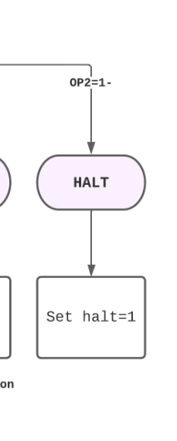
How do WE halt?
Most efficient solution? Stop the controller!

Slide 13
How do WE halt?
Most efficient solution? Stop the controller!

Slide 14
Halting in microstore?

Slide 15

Halting in microstore?
Jump to an empty location. Problem solved.

Slide 16
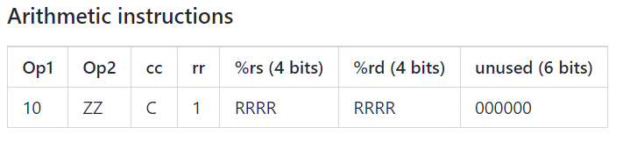
How do we know that the datapath is ready?
The datapath/ALU/memory may need more than one clock cycle to get an instruction done
If the controller keeps pushing instructions -> problem!

Slide 17
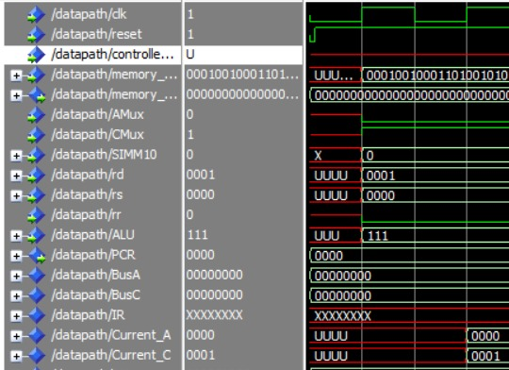
First solution: can we get every operation done in one cycle?
Metastability

Slide 18
SECOND solution: can the contents of the fsm change?
No, because loops (counters) in a FSM are unwanted
And it would mess with our PC

Slide 19
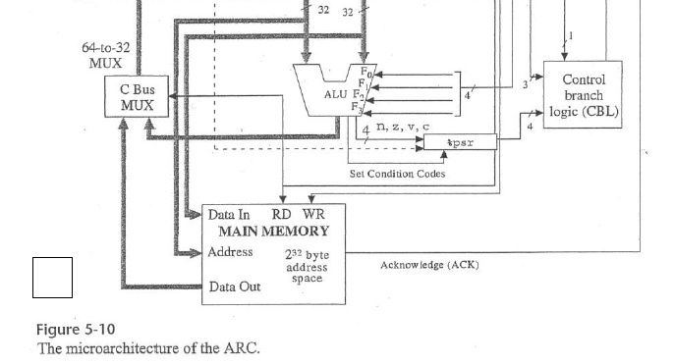
So, we need to able able to cope with multiple clock cycles
How?

Slide 20
The implications of using a FSM

Slide 21
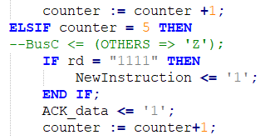
Acknowledge!

Slide 22
How does microstore know that the datapath is ready?
It’s natively baked in.

Slide 23
DEBUG MODE
Requirements
Load the contents of a memory address and display it using the seven-segment displays

Slide 24
Debug mode
2 new signals added to the controller allowing the DEBUG to step through the code 1 line at a time.
”DEBUG” is 1 if the debug switch is turned on.
”DEBUG_NEXT” is 1 for exactly 1 clock cycle when a user presses the 'next line' button.

Slide 25
Debug mode
How can we set ”DEBUG_NEXT” to 1 for exactly 1 clock cycle => ”Debugging_Facilitators”
It handles the input and transforms it to the required signal
”Debugging_Display”
Debug harder to realize with microstore

Slide 26
Debug mode in microstore
Harder to realize with microstore instructions

Slide 27
So, what have we learned?

Slide 28
Our hypothesis
FSM Microstore
Quite elegant for small instruction sets
Human readable
Debugging can be easily implemented
Can get quite large
Scales better for larger instruction sets
Halting is easier
No problems with longer ALU instructions
Not human readable
Requires a large LUT small instruction sets

Slide 29
Conclusion

Slide 30
Demo

